Slide 1
VIDEO 101
Best practices, tips, and resources for content creators
Christina Bristol & Christy Zwicke

Slide 2
STORYTELLING EXERCISE
Pair up
What’s the best present you ever received?
2 minutes

Slide 3
STORYTELLING EXERCISE
Share an example
What makes for a good story?
Beginning, middle, and end
Background information and context
Feelings
Emotional connection
Wrap it up

Slide 4
STORY FIRST
Everyone has a story
People don’t care how much you know, until they know how much you care
Make people feel – emotion, fear, humor, excitement
Video is just one way to tell a story

Slide 5
BEFORE YOU START
Think about your goals
Know your audience and what they want
How are you going to use it?
  To promote or capture an event?
  To raise money or appeal to donors?
  On your website as a pretty visual?
  Something fun for social?
Why should people care?
How do you measure success?
https://o365ucr-my.sharepoint.com/:b:/g/personal/zwicke_ucr_edu/EXoCpXYXykVKnjwFk6jDXg8BT0QU101ZAu1CpCwarOwdnw?e=dPzml4

Slide 6
DIFFERENT VIDEO APPROACHES
Talking heads
  https://www.youtube.com/watch?v=ubxhCYvpqxM
Voice over narration
  https://www.youtube.com/watch?v=NcrpBRubJVU
Information driven
  https://www.youtube.com/watch?v=TT3yA2KTdGM
Music driven
  https://www.youtube.com/watch?v=8RbTL-248N0
Website Videos
  https://www.ucr.edu/

Slide 7
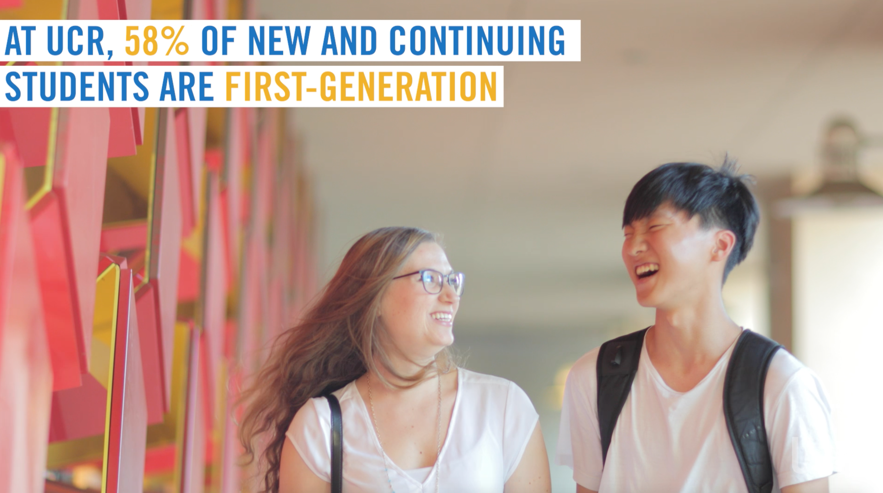
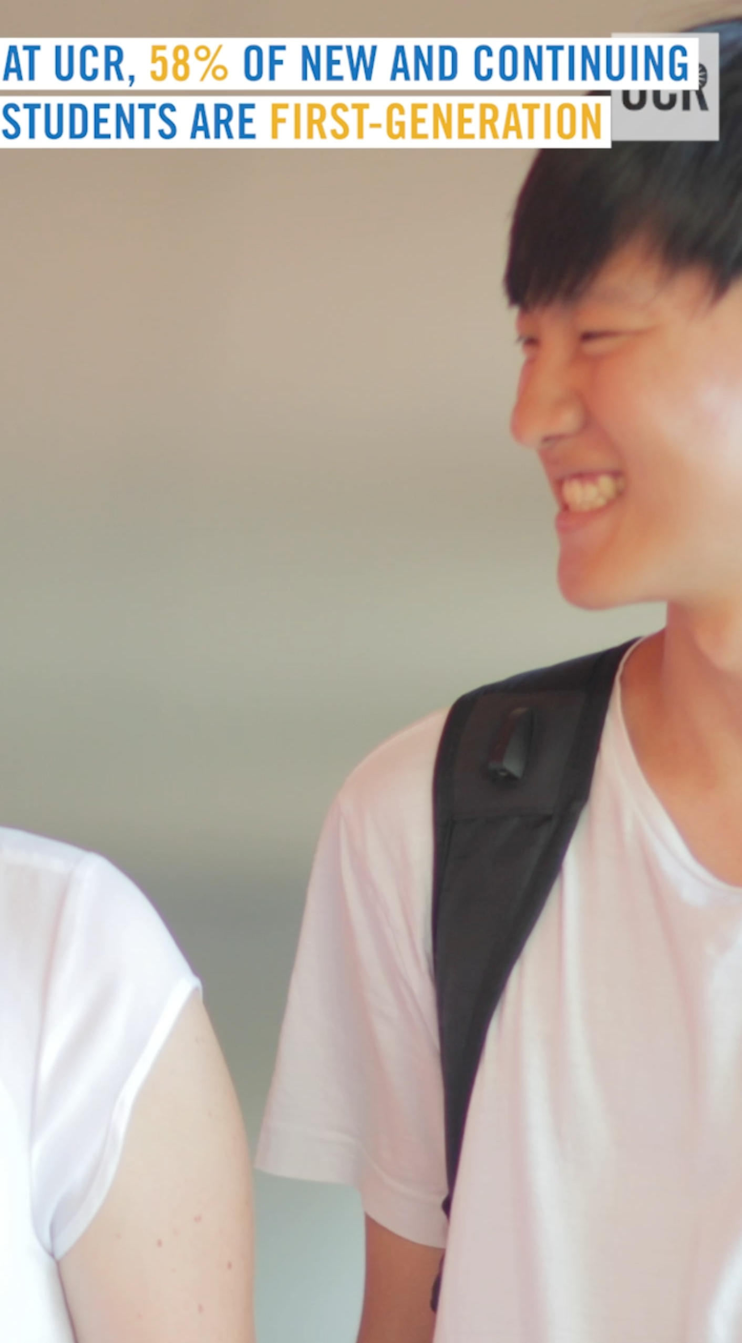
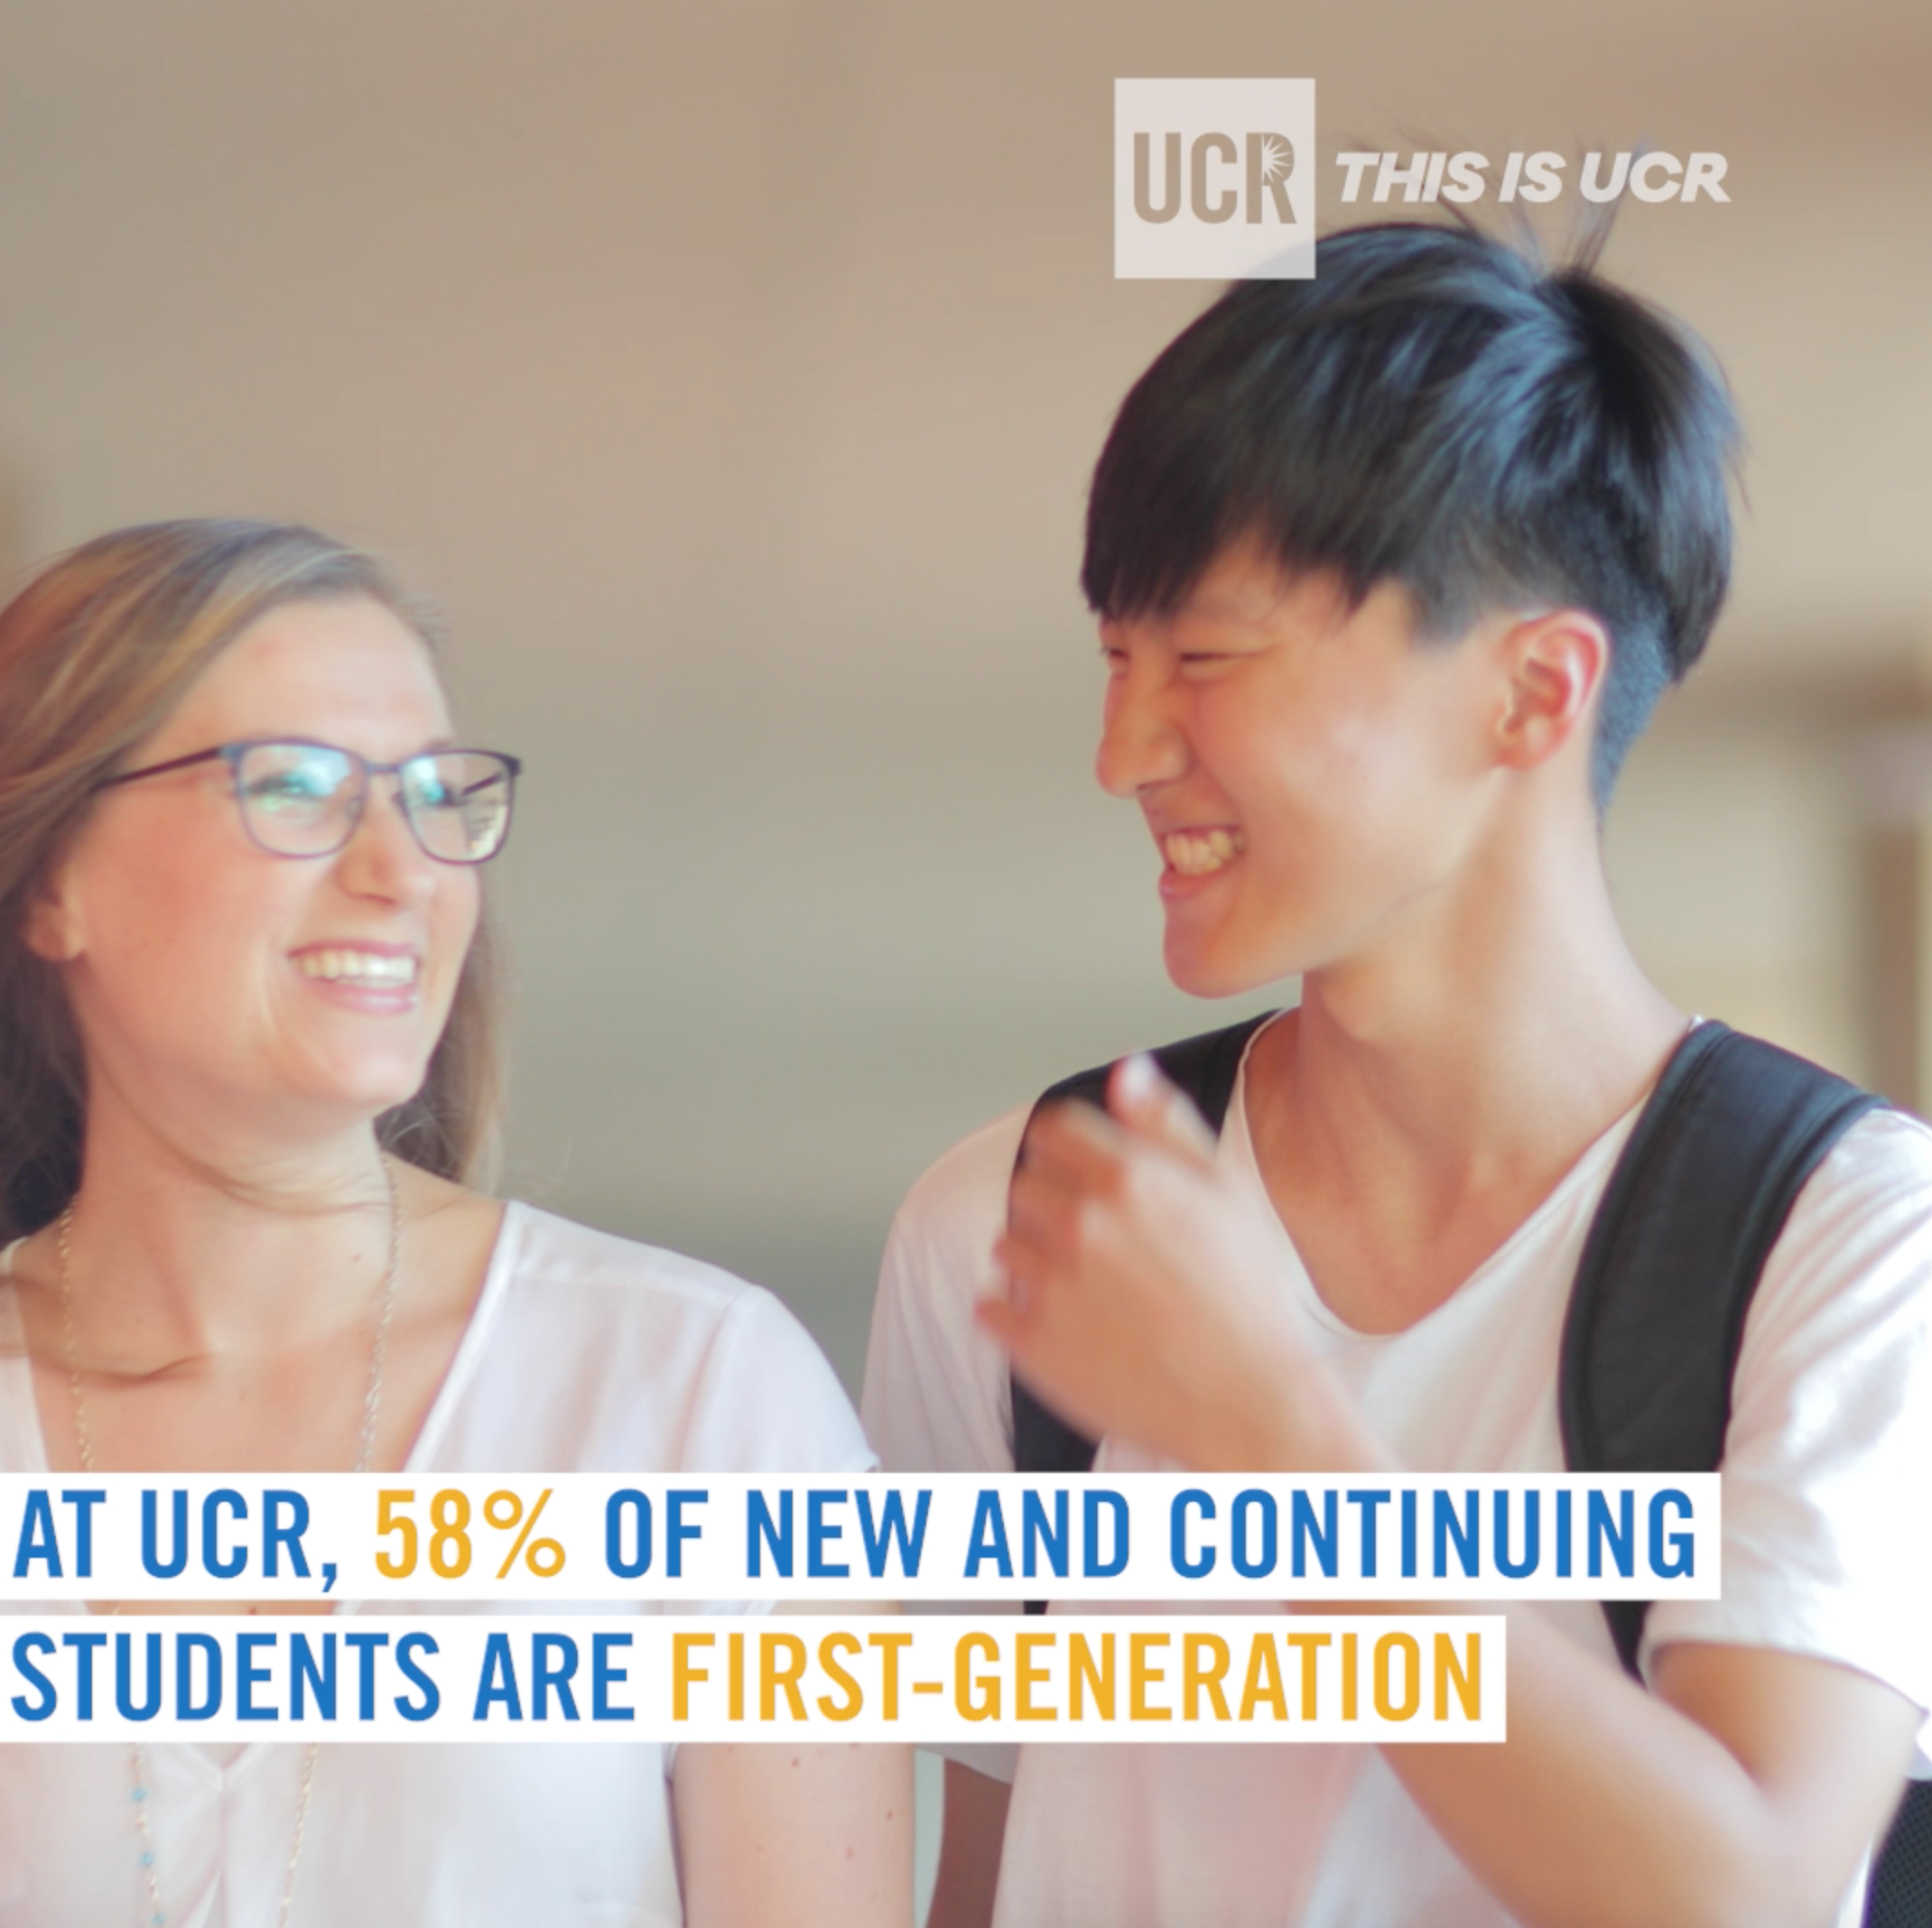
PLATFORMS
YouTube
YouTube live
YouTube 360
Facebook
Facebook live
Facebook 360
Instagram
Instagram Story
Instagram live
Instagram TV
Twitter
Linked In
Vimeo
Look up platform requirements for format & duration as they are always changing
Horizontal vs. square vs. vertical
Make it shareable

Slide 8
CREATE ONCE, USE MULTIPLE WAYS
Make your video evergreen
  Talking head videos might be harder to keep evergreen
  Avoid dates or other time-sensitive information
Follow ever-changing platform settings for different exports
EXAMPLE = CAM CALKINS
  YouTube version
  Facebook square version

Slide 9
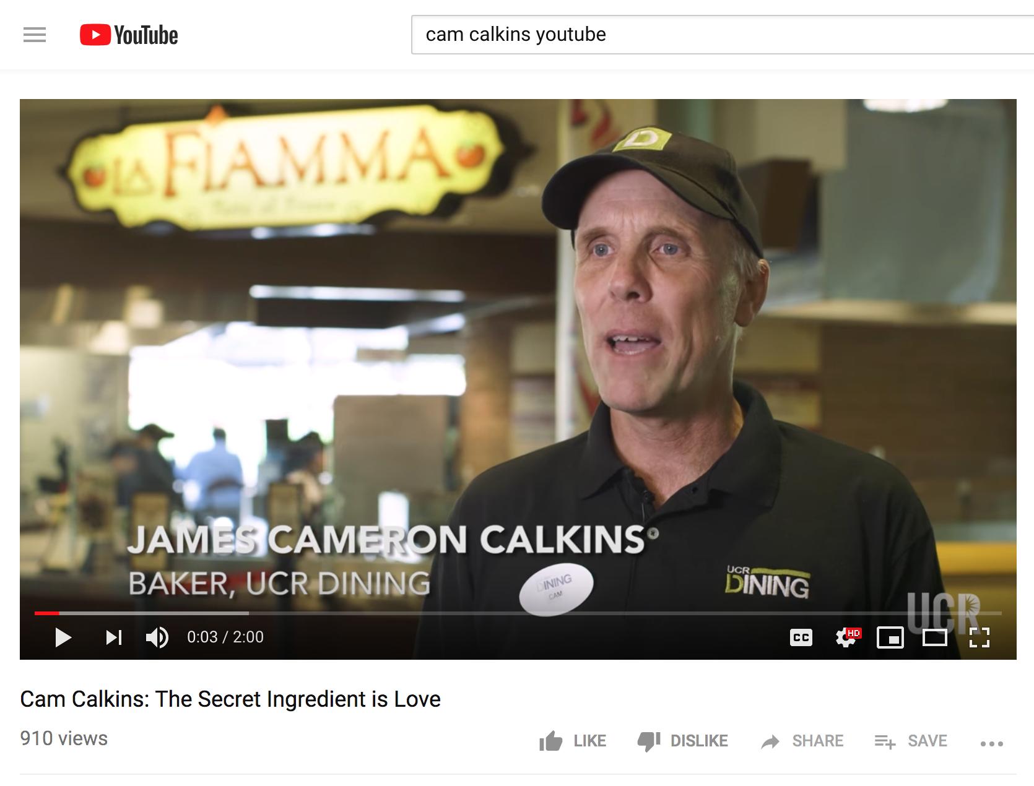
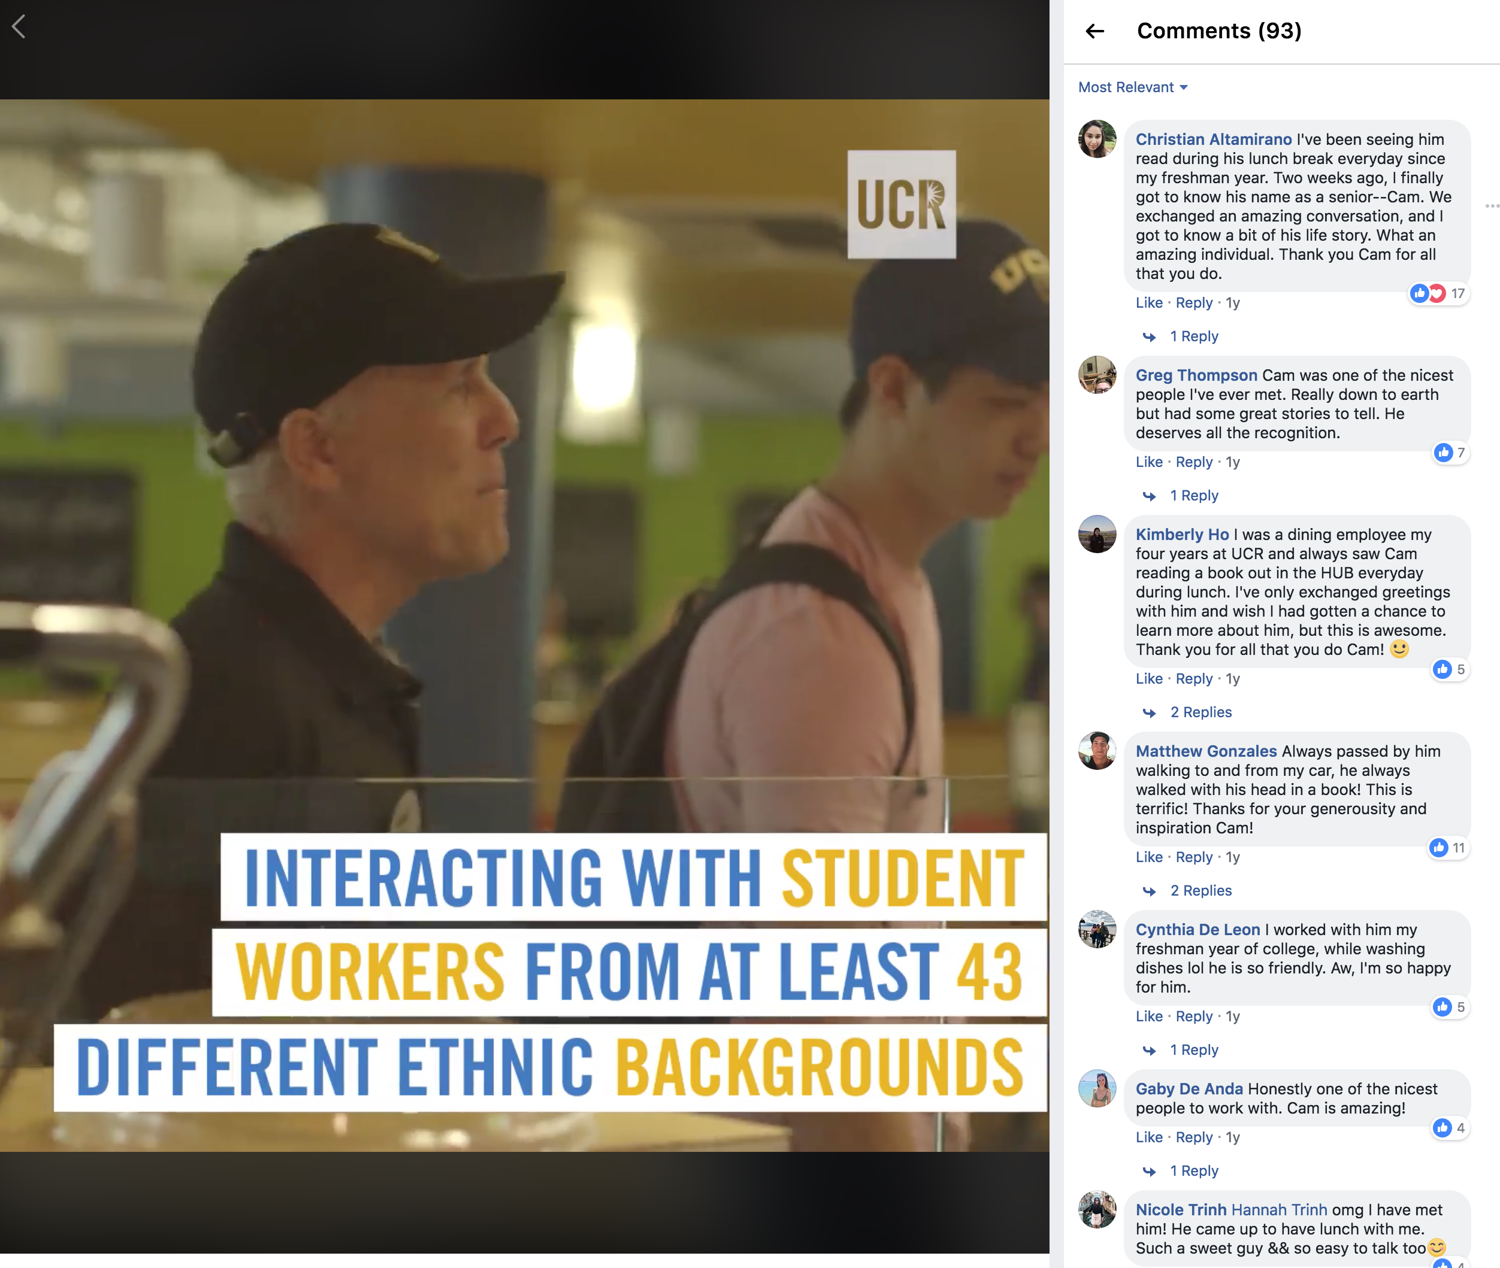
EXAMPLE OF MULTIPLE PLATFORMS
https://www.facebook.com/UCRiverside/videos/vb.102657818085/10155894793103086/?type=2&theater

Slide 10
FRAMING: SETTING UP YOUR SHOT
Storytelling in the background
Wide, medium, close up shots
Rule of thirds
Use a tripod or have steady hands
Example:
https://vimeo.com/299777028/e124cdb3a2

Slide 11
LIGHTING
Is there enough light to see your subject?
Are they facing the light?
Don’t blow out the background – pick all one level
Deep shade is ideal
Example
https://vimeo.com/299774607/d53a745036

Slide 12
SOUND
Can you hear your subject?
Is there background location noise?
Watch out for interruptions (airplanes, cars, people)
Use an external mic, if possible
Example
https://vimeo.com/299779024/f4892c192a

Slide 13
EDITING
Keep it short
Tailor it towards your audience
Use BROLL to enhance the story
Add music if necessary
First 5 seconds are most important
Example of good broll:
https://vimeo.com/300792075/efe17287e1

Slide 14
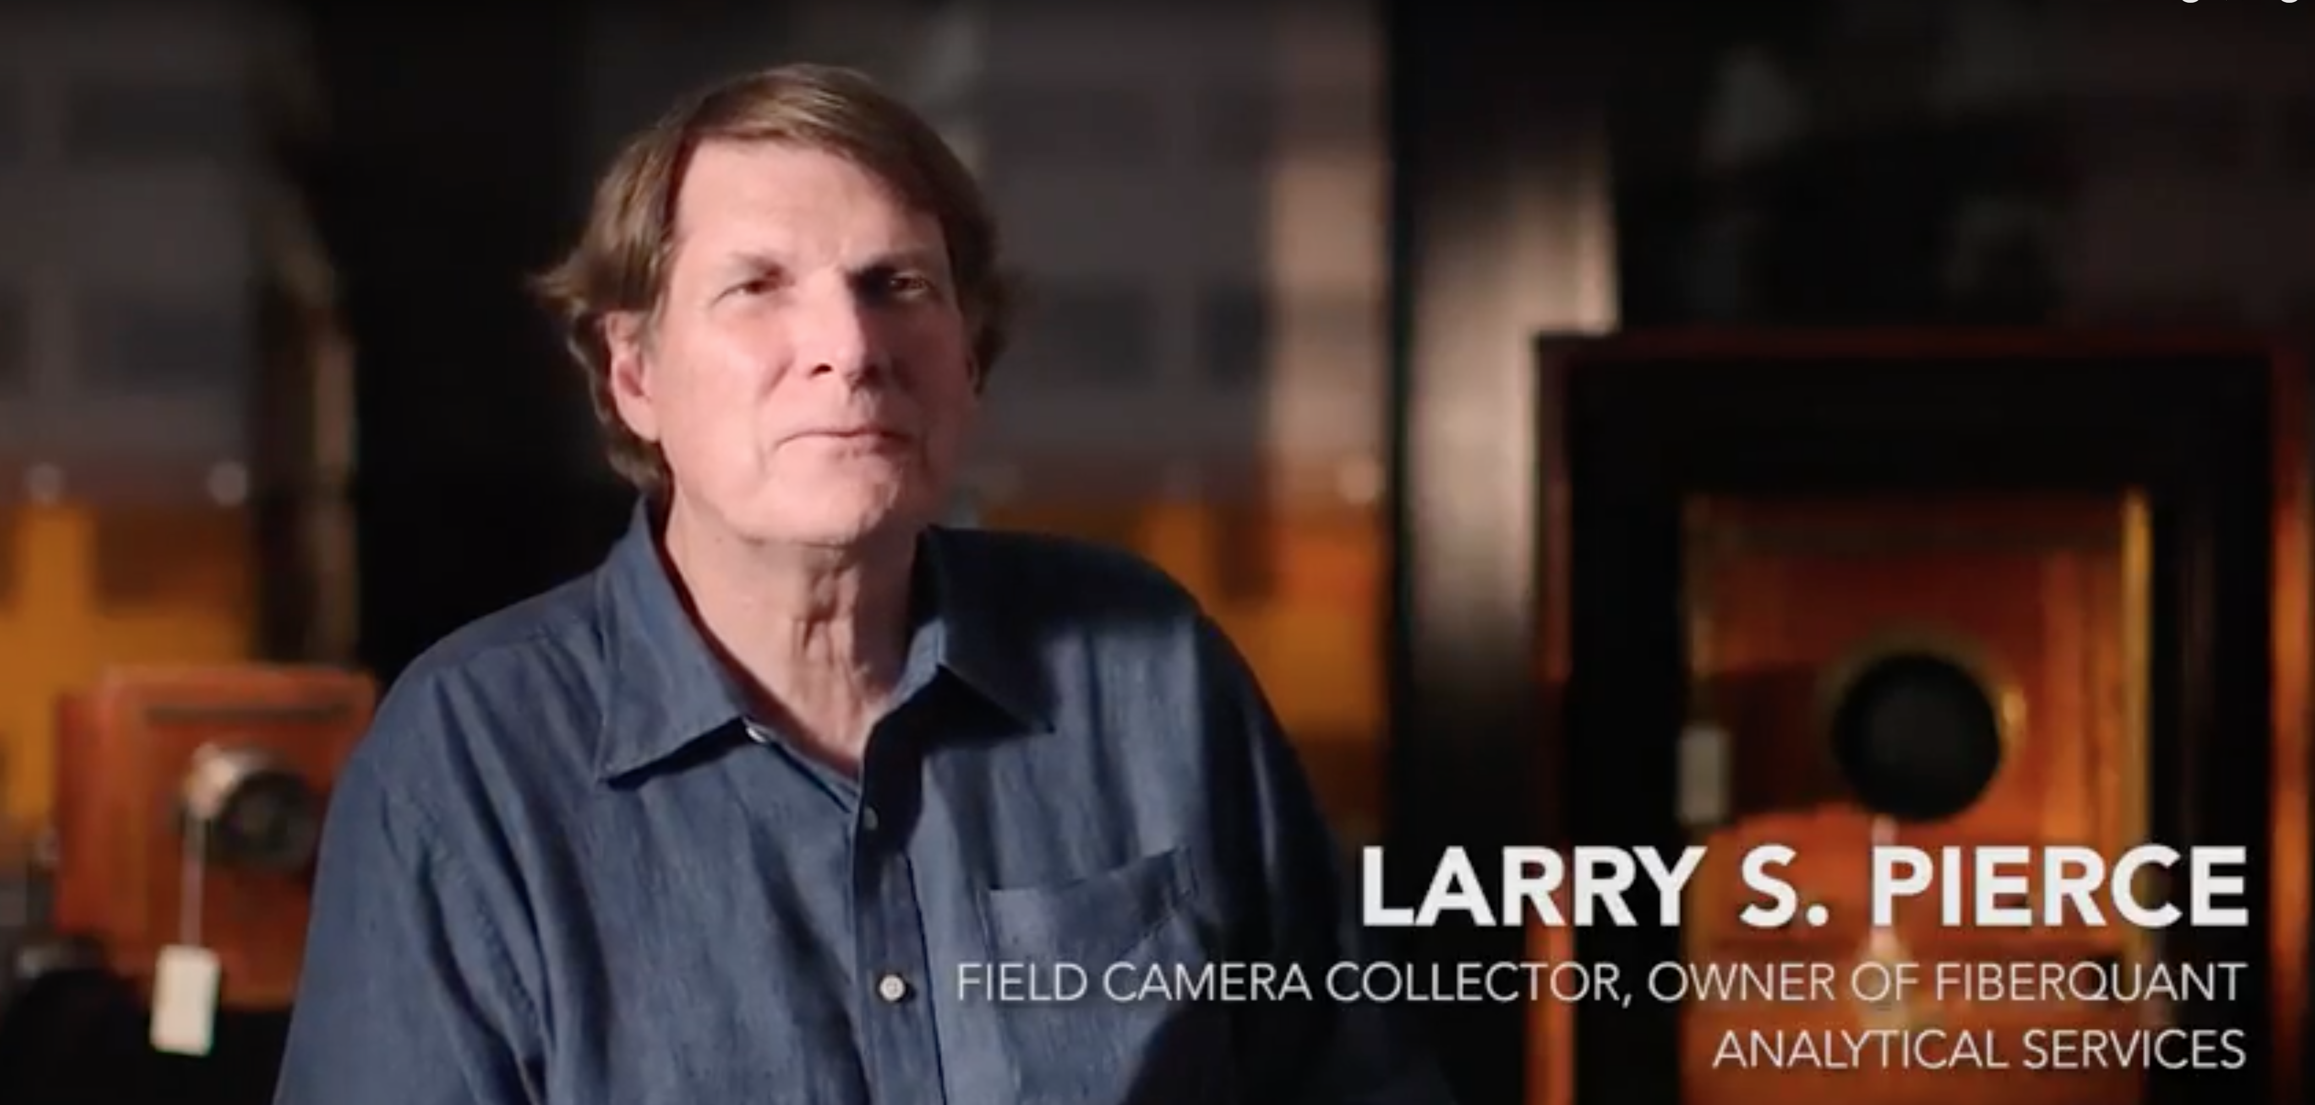
GRAPHICS
KEEP IT SIMPLE
  Don’t make fonts too fancy
Keep it short
Make it easy to read
  Contrast Ratio requirements
Use “lower thirds” to identify talking heads
Follow campus branding guidelines
  https://creativedesign.ucr.edu/ism/logos.html

Slide 15
TIPS FOR SHOOTING ON A PHONE
All those sample videos were made on a phone!
Use a tripod or phone holder, if possible
Get good sound
Prep your phone
  Check storage space
  Check battery
  Adjust settings - 1080 or 4K?
  Put in airplane mode, do not disturb, block messages
  Clean & use the rear camera lens
Practice your shots

Slide 16
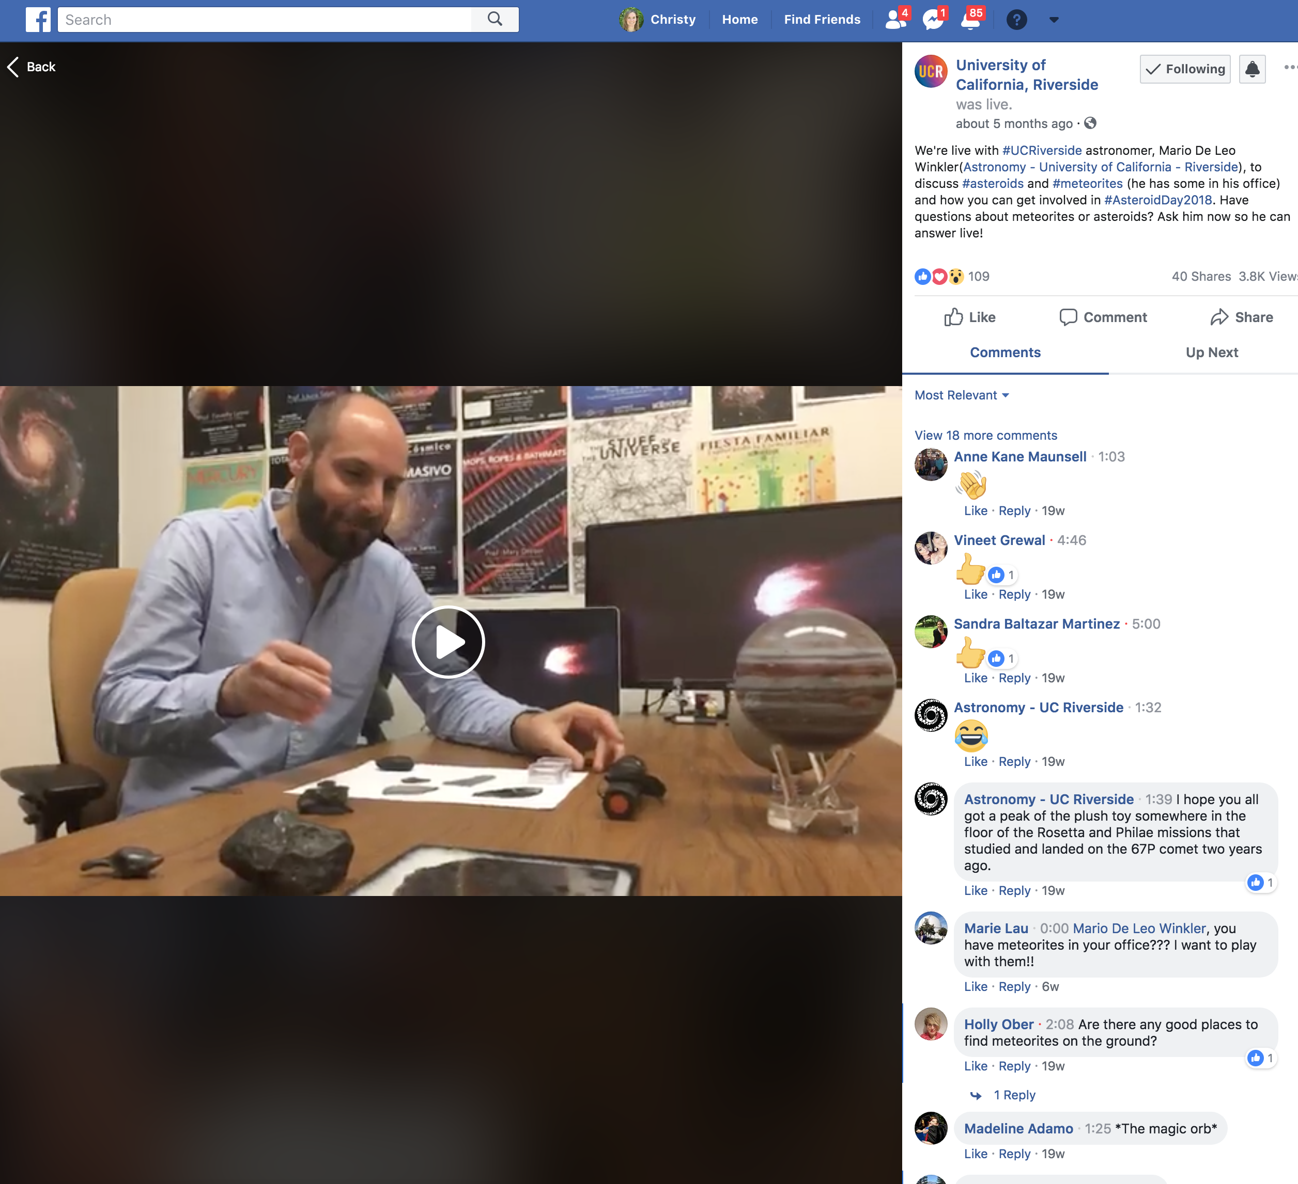
TIPS FOR LIVE SOCIAL VIDEOS
Promote it in advance
Work with talent ahead of time to prepare
Find a good background location
Start the video with a tease
Make it interactive
  Questions from the audience
    Have backup questions ready
Close with a call to action
  like our page, share, subscribe
Follow up – go back and answer questions
Use in other ways – upload to YouTube

Slide 17
EQUIPMENT
Audio
  Wire Lavalier microphone $20
    https://www.amazon.com/Omnidirectional-Lavalier-Microphone-Camcorder-Recorders/dp/B00NHN168W?th=1
  Shotgun microphone $40
    https://www.amazon.com/BOYA-Universal-Cardiod-Microphone-Camcorder/dp/B06XWH97X8/ref=sr_1_2?ie=UTF8&qid=1518492340&sr=8-2&keywords=boya+bymm1
  Mobile Interview kit with 2 lav mics - $200
    https://www.bhphotovideo.com/c/product/1428666-REG/rode_sc6_l_mobile_interview_kit.html?ap=y&gclid=EAIaIQobChMIlpv07MjA3gIVGP5kCh3SJwilEAQYASABEgLb6PD_BwE&smp=y
  Wireless microphone pack - $329
    https://www.amazon.com/Rode-RodeLink-Wireless-Filmmaker-System/dp/B00TV90DX0
Stabilizers
  Tripod - $90
    https://www.amazon.com/Slik-617-520-Video-Sprint-Tripod/dp/B0033333KU/ref=sr_1_11?s=photo&ie=UTF8&qid=1475294198&sr=1-11&keywords=slik+tripod+II
  Adaptors to put a phone on a tripod - $12
    https://www.amazon.com/dp/B00I58NYQQ/ref=wl_it_dp_o_pC_nS_ttl?_encoding=UTF8&colid=1CY5M13XB9PDM&coliid=I8MS0HEG560R
  Tripod for a phone
    https://www.amazon.com/Arkon-iPhone-Tripod-Galaxy-Retail/dp/B00SZHIESK/ref=pd_ybh_a_4?ie=UTF8&psc=1&refRID=Z51H9BKSCR1YVEVXM7D5
Basic lights and/or light modifiers
  Shoe mount $32
    https://www.amazon.com/YONGNUO-YN300-Air-Temperature-3200K-5500K/dp/B0157PE1ZC/
  DIY light kit - $100
    https://wistia.com/learn/production/down-and-dirty-lighting-kit
  Good ‘ol Reflector - $50
    https://www.bhphotovideo.com/c/product/1274713-REG/impact_r2542_51_42_5_in_1_collapsible_circular.html
UCR receives a discount through B&H
  All in one light, tripod, and microphone kit $200
    https://www.bhphotovideo.com/c/product/1302409-REG/lume_cube_ios_video_kit.html

Slide 18
VIDEO EDITING APPS
iMovie comes on iOS devices
  Can add stills, music, filters, titles
  Can export to a Mac desktop for more processing if needed
PowerDirector for Droids
  Quickly arrange clips, trim, and add to timeline
  Might be limited on export options
Adobe Spark
  Basic is FREE, or you can pay for more features $10/month
  Desktop and mobile
  EASY TO USE
  Created branded photos, videos, and graphics
  Log in with Facebook, Creative Cloud
  https://spark.adobe.com/pricing/?gclid=EAIaIQobChMIoYbdi77S3gIVE9VkCh0aqwdhEAAYASAAEgJyb_D_BwE&mv=search&ef_id=EAIaIQobChMIoYbdi77S3gIVE9VkCh0aqwdhEAAYASAAEgJyb_D_BwE:G:s&s_kwcid=AL!3085!3!284648606115!b!!g!!adobe%20spark
Feelin’ fancy? Use Adobe Premiere Rush
  For more advanced users
  Lets you easily change between portrait and landscape modes
  ONLY on iOS, Mac, and Windows
  First 3 projects are free, after that $10/month
  https://www.adobe.com/products/premiere-rush.html

Slide 19
BE A GOOD CONTENT CREATOR
Ask permission before filming
  Video release forms, as needed
  Minors need parental consent
Drone requirements
  https://www.ucop.edu/enterprise-risk-management/resources/centers-of-excellence/unmanned-aircraft-systems-safety.html
Filming in labs: folks should have labcoats, eyegear, gloves (as required)
You are representing the University in these videos, beware of dress code

Slide 20
NEW FREELANCERS!
Christen Marquez
  (917) 428.4984
  Email: christen.marquez@gmail.com
Neil Murko
  (760) 317-6404
  Email: neilmurcko@gmail.com
  Website: https://www.neilmurcko.com/video/
Carly Scholte
  Email: carlyscholte@gmail.com
  Website: https://www.carlyscholte.com
Josh Kulic
  Cell: 909.556.4970.
  Email: josh@vstormpro.com.
  Website: www.vstormpro.com

Slide 21
WHAT TO ASK A FREELANCER
Consider using the creative brief to help prep your request
Clearly define the scope of work
Ask for examples of their videos
Send them examples of videos that you like
Get multiple quotes

Slide 22

FREE MUSIC
UCR has a Warner Chappell Production Music subscription
Avoid using music that is not licensed – otherwise annoying things will happen
Keep an eye out for copyright disputes

Slide 23
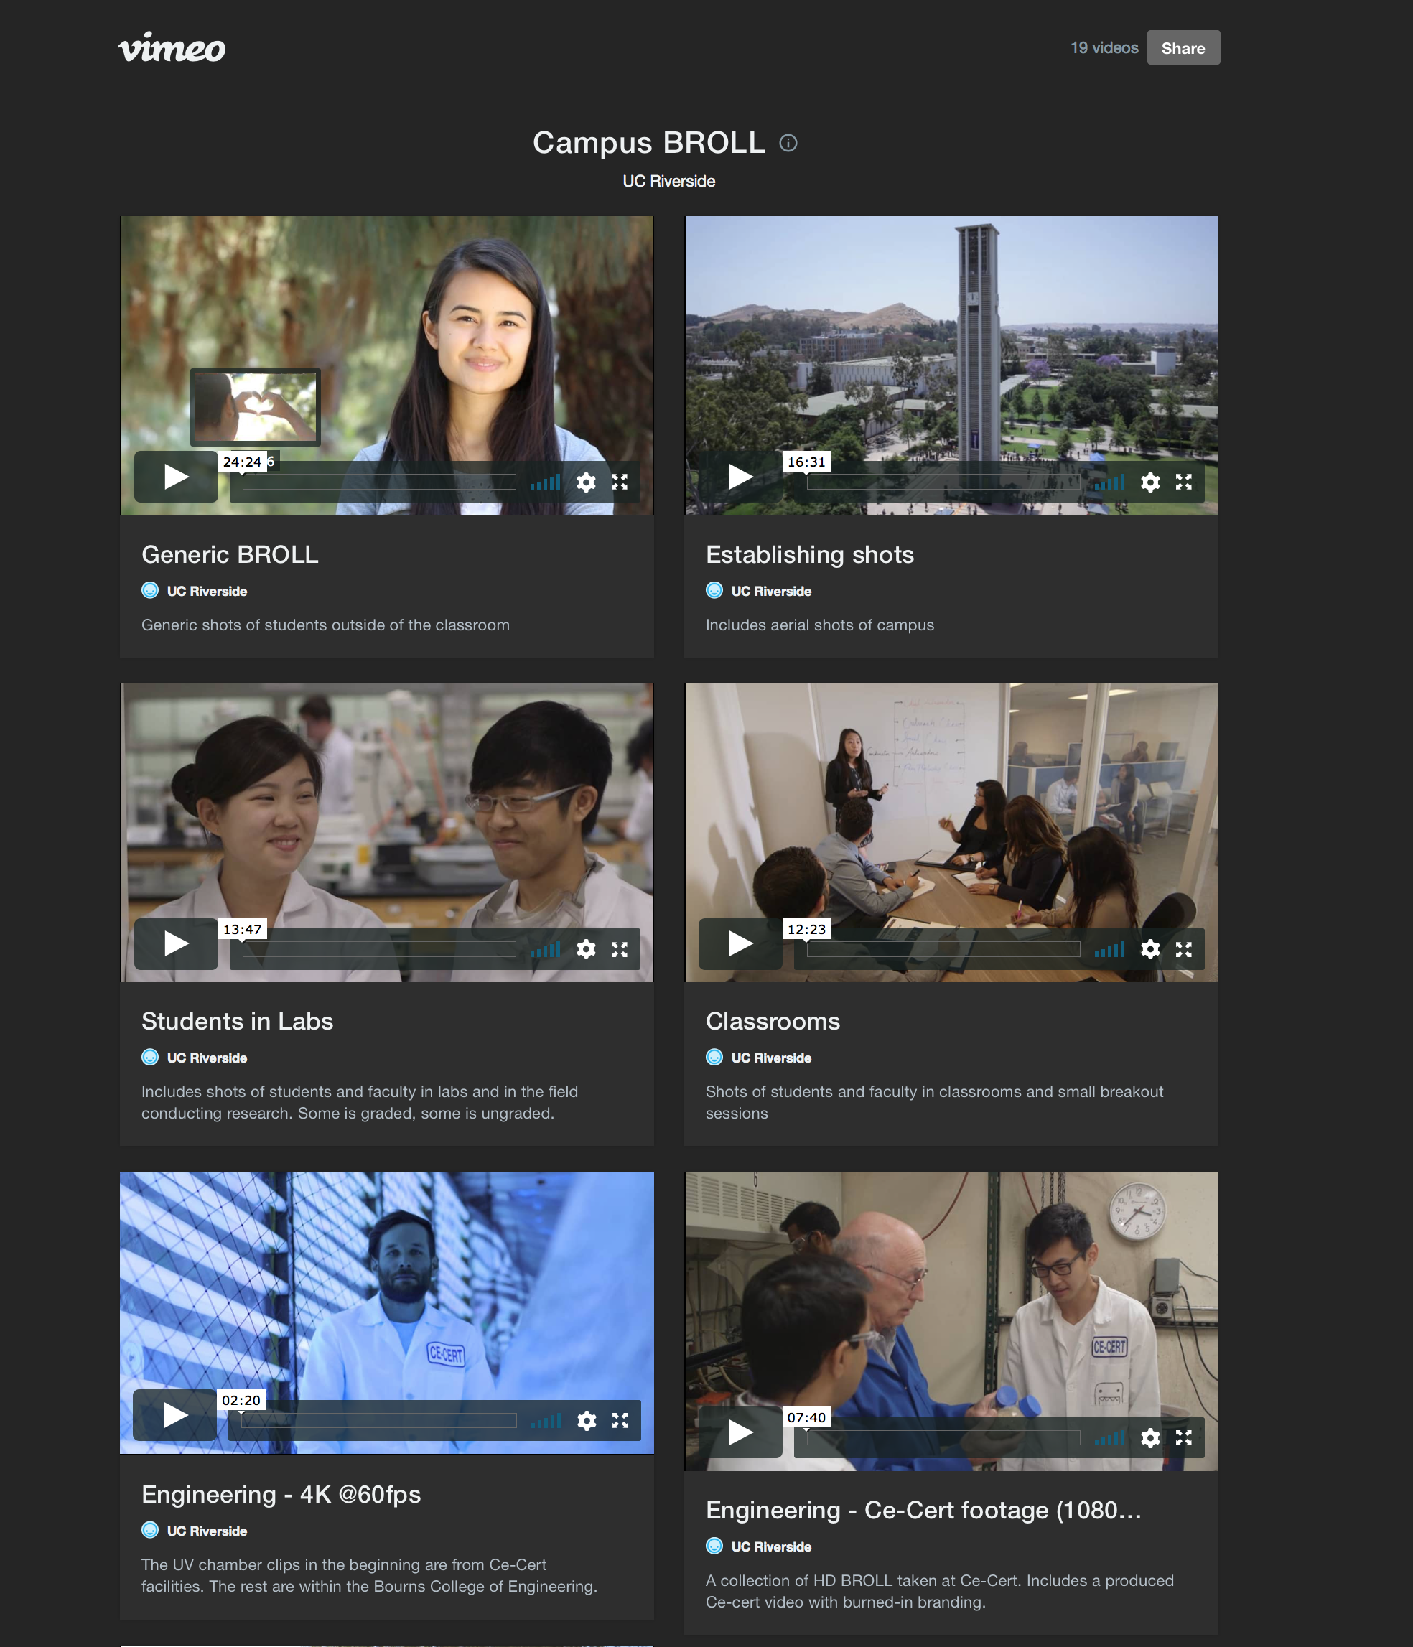
FREE BROLL https://vimeo.com/album/5305405

Slide 24
HAVE FUN!

Slide 25
SUBSCRIBE AND SHARE
YouTube
  https://www.youtube.com/user/ucriverside
Facebook - ucriverside
Instagram - ucriversideofficial
Twitter - #ucriverside
Linked In - ucriverside
Send us your stuff!
Sharing is caring

Slide 26
THE END
Call or email if you would like more information
Christina Bristol - 951-827-2630 christina.bristol@ucr.edu
Christy Zwicke - 951-827-4593 christy.zwicke@ucr.edu

